Slide 1
Introduction to Data Science Challenge
(XGBoosters)

Slide 2
Approaches
Traditional Approach
Exploratory Data Analysis
Feature Engineering
Feature Generation
Feature Selection
Model Evaluation
Time Series Analysis
Exploratory Data Analysis
Feature Selection
Feature Engineering
Model Evaluation

Slide 3
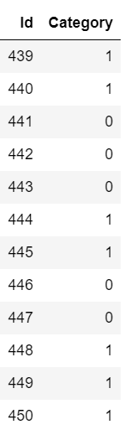
Why we moved to time series analysis?
Category column contains consecutive 1’s and consecutive 0’s
So past input values influence the present result

Slide 4
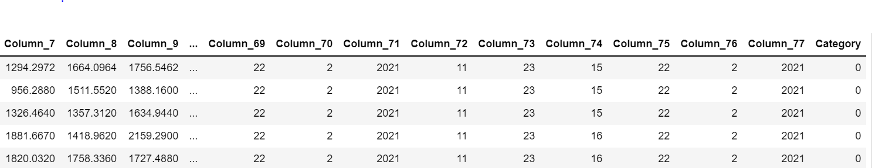
Data Preparation
Used window method
Window size = 4
t-3
t-2
t-1
t

Slide 5
Feature Engineering
Time related columns are removed while data cleaning
Used MinMax scaler to scaled the data set

Slide 6
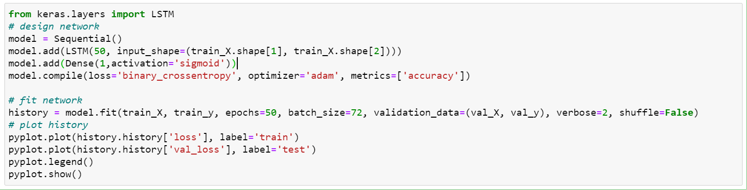
LSTM

Slide 7
Random Forest

Slide 8
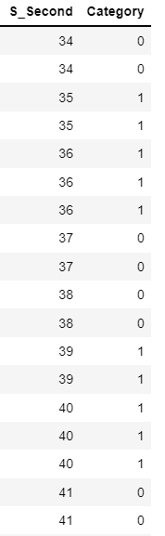
Key Insights
If the value of category in n^{th} second is 1, then mostly all values of category in n^{th} second is 1.
So if any one of the nth second category is 1 the fill the every nth second values as 1

Slide 9
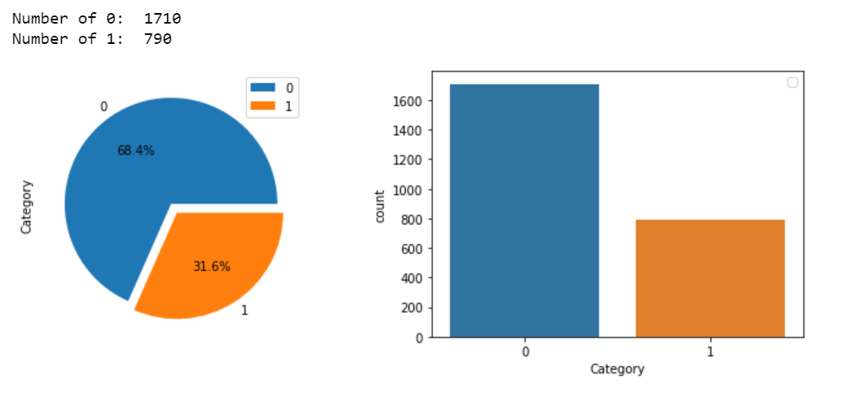
Measuring Performance of model
This data set is imbalanced data set so to improve overall accuracy, so we focus on accuracy ,recall and precision
We choose confusion matrix and classification report from sklearn.metrics library to evaluate the model

Slide 10
Ensemble Learning
We combine the result of LSTM and Random forest.
Then we get final output after filling 1s if any one of the start second is predicted by 1

Slide 11
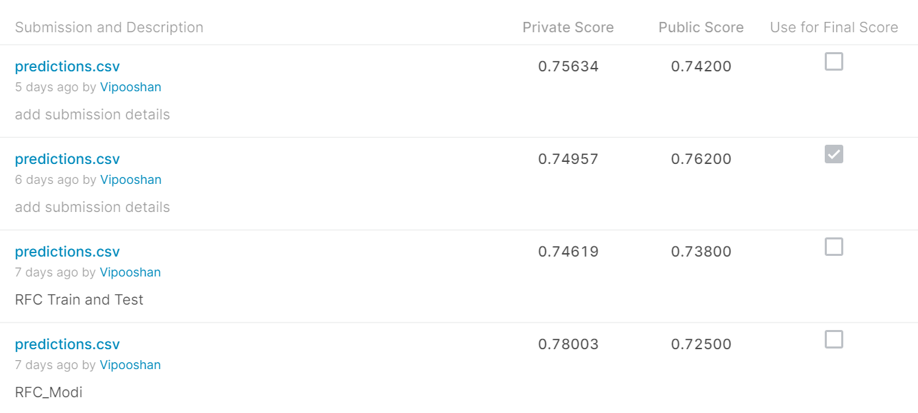
Final Output

Slide 12
Thank You

